Slide 1


Presidential, Judicial, Legislative, and Natural Indicators of Mid-term Congressional Seat Changes
Nicole Levin, Pramodini Karwande, Darlene Agle

Slide 2
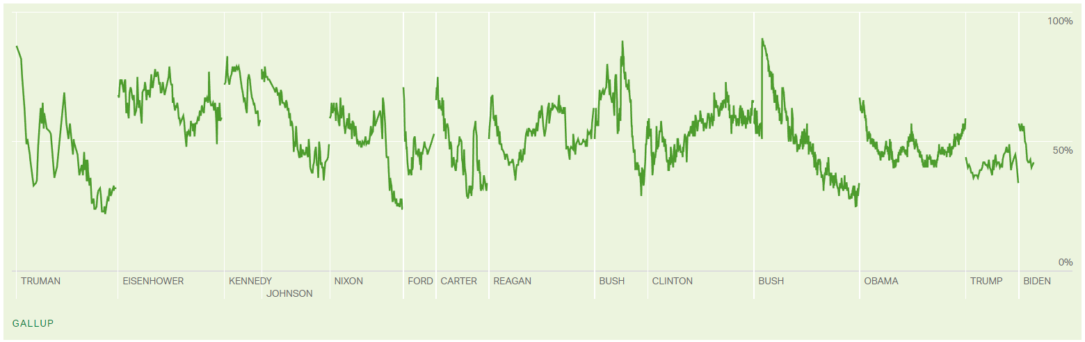
Motivation: Midterm elections usually result in a net Congressional seat loss for the sitting president’s party. Gallup has observed that this loss tends to be much larger when the sitting president’s approval rating is below 50%. We wonder about the strength of presidential approval as an indicator compared to the approval ratings of the other branches of government.
Notes:
According to Gallup, midterm elections usually result in a net Congressional seat loss for the sitting president’s party. Gallup has also observed that this loss tends to be much larger when the sitting president’s approval rating is below 50%. We wonder how much this association weakens when considered in conjunction with the approval ratings of the other branches of government. We would like to evaluate whether mid-term congressional seat loss for the president’s party is more strongly associated with approval of Congress, approval of the President, approval of the Supreme Court, or with simple natural pattern.

Slide 3
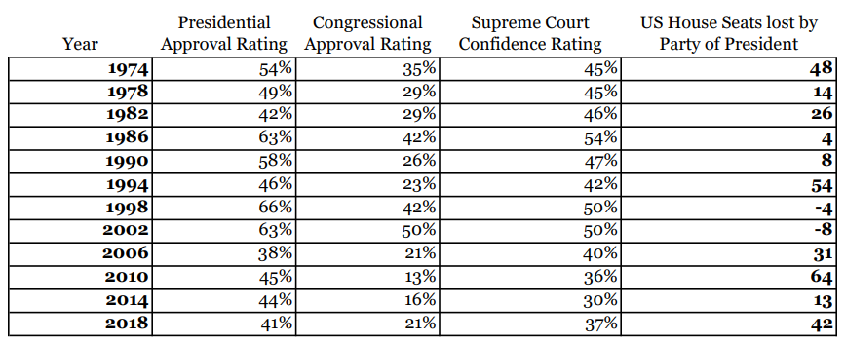
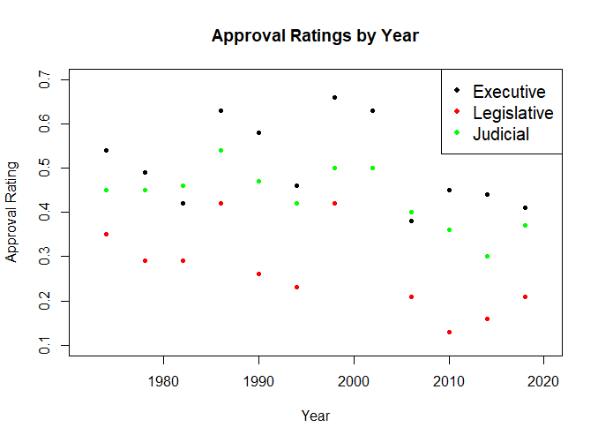
Data collected from news.gallup.com
Notes:
Data: We collected our historical polling data from Gallup, with surveys running as far back as 1974 for each of our desired variables (the Supreme Court and Congressional approval surveys only went back that far). This provides for us a sample of 12 midterm elections. We also collected the corresponding mid-term US House election results from public records.

Slide 4
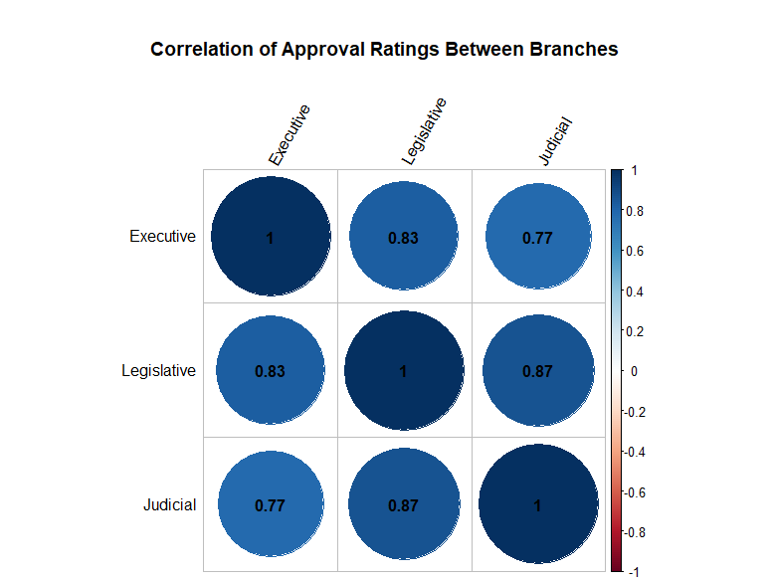
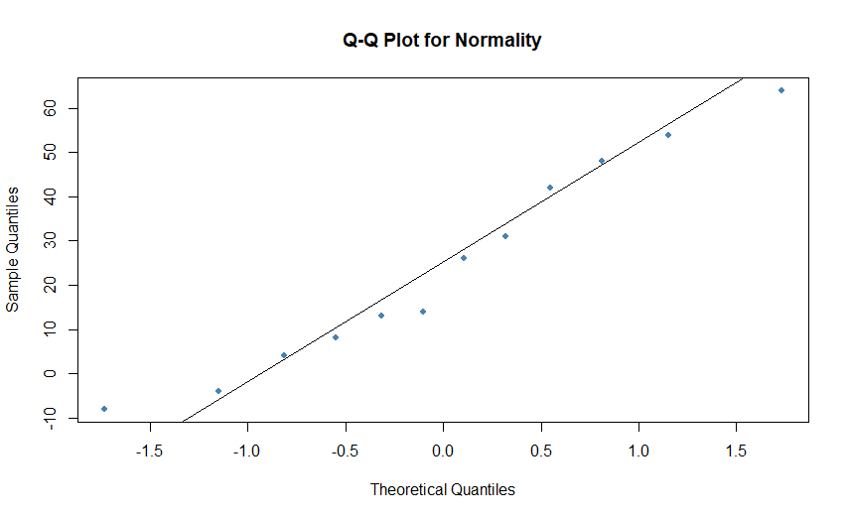
Evaluating Variable Behavior
There is a very high correlation between the approval ratings of all three branches of government.
Number of seats flipped appears to have a satisfactorily Normal distribution for linear modeling.
Darlene Agle
Notes:
We observed high correlation between the approval ratings of all three branches of government. This would suggest that the approval rating of any one branch might suffice in a model, but we are interested in the relative influence so will keep them each as variables. We performed a Q-Q plot on our dependent variable to evaluate the plausibility of Normality. We found the number of seats flipped to have a satisfactorily Normal distribution for linear modeling.

Slide 5
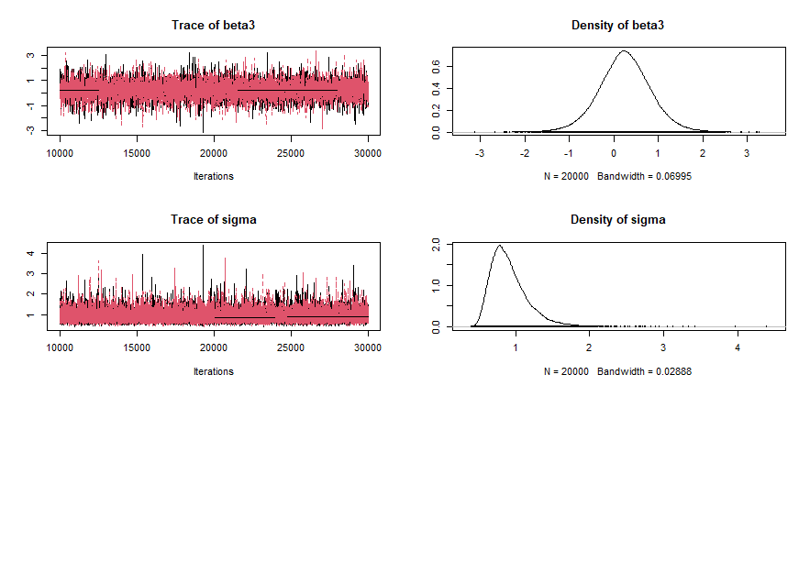
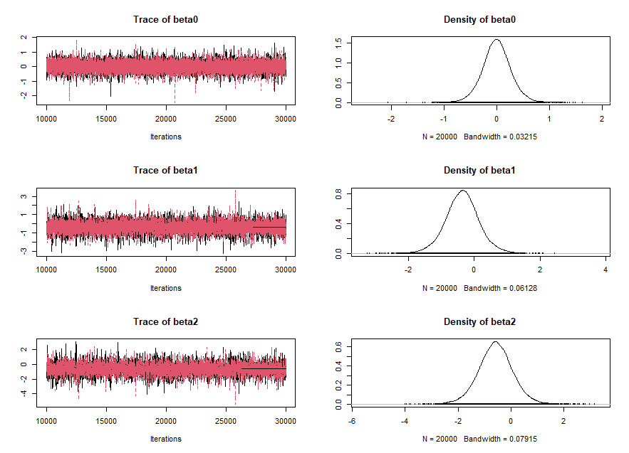
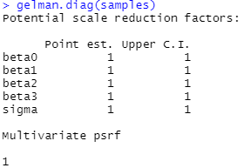
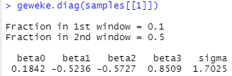
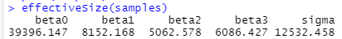
Bayesian Simple Linear Model
Y_{i}~ Normal(β₀ + X_{i1}β₁ + X_{i2}β₂+X_{i3}β₃, σ²)
X_{i1}=Presidential approval rate X_{i2}=Congressional Approval Rate X_{i3}=Supreme Court confidence rate
Darlene Agle
Notes:
We first constructed a Bayesian linear model with Yi (the number of presidential-party seats lost), standardized and distributed Normally with an uninformative prior. We standardized the covariates as well and gave them independent, uninformative Gaussian priors to help address their collinearity. We then performed an MCMC sampling with 10000 burn-in samples and 20000 post-burnin samples. With even trace plots, low autocorrelation by lag 5, effective sample sizes over 1000 for each parameter, a Gelman-Ruben convergence diagnostic reduction factor under 1.1, and Geweke’s Convergence Diagnostic less than 2, all of our convergence diagnostics were satisfied.

Slide 6
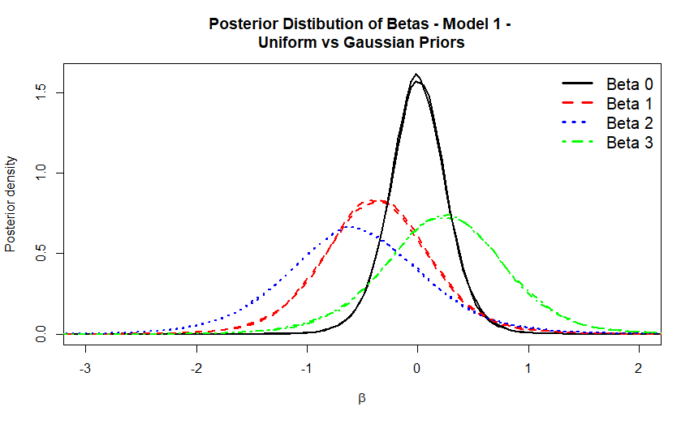
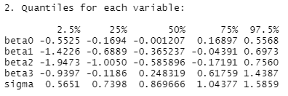
Bayesian Simple Linear Model
Y_{i}~ Normal(β₀ + X_{i1}β₁ + X_{i2}β₂+X_{i3}β₃, σ²)
X_{i1}=Presidential approval rate X_{i2}=Congressional Approval Rate X_{i3}=Supreme Court confidence rate
Darlene Agle
Notes:
To evaluate the sensitivity of the model to the priors, we ran the model again with Uniform priors instead of Gaussian. The posterior distribution of our Beta variables was robust to this change. While median value for the Congressional approval coefficient had a larger absolute value than the median value for the presidential approval coefficient, the credible intervals for the values of each of the coefficients overlapped significantly.

Slide 7
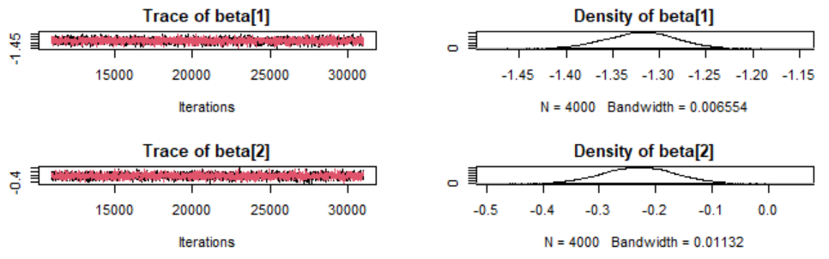
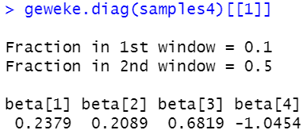
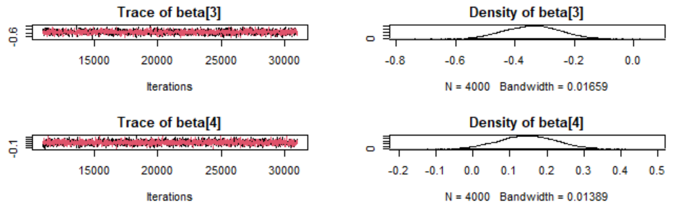
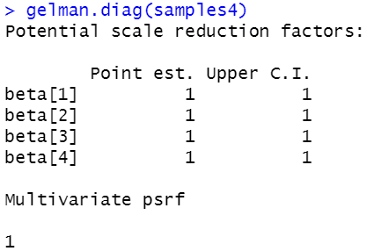
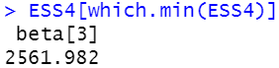
Binomial – Logistic Model
Y_{i}~ ~ Binomial(p[i], n[i])
Probit(p[i]) ~ (β₁ + X_{i1}β₂ + X_{i2}β₃+X_{i3}β₄)
X_{i1}=Presidential approval rate X_{i2}=Congressional Approval Rate X_{i3}=Supreme Court confidence rate n=Number of races run
Y_{i} = US House seat loss by party of president (0,1)
Pramodini Karwande
Notes:
Question? What is the probability that a sitting President’s party will loose the seat or hold it, given the data president approval rating right before the midterm election, Congressional Approval rating and Supreme court confidence rating. We redefine our Y_{i} between 0 and 1 and used likelihood as binomial model with an uninformative priors. Since, our dependent variable can take only two outcomes , we decided to use link function as type of logistic regression model. Here, Probit model came into picture which uses cumulative standard normal distribution to predict. We performed the rest of the steps same as SLR from the previous slide , proceeded ahead with MCMC sampling using 10000 burn-in samples and 20000 post-burnin samples. Model Convergence Diagnostic provided approximately same results as SLR for Gelman-Ruben , Geweke but better effective sample size ~2562.

Slide 8
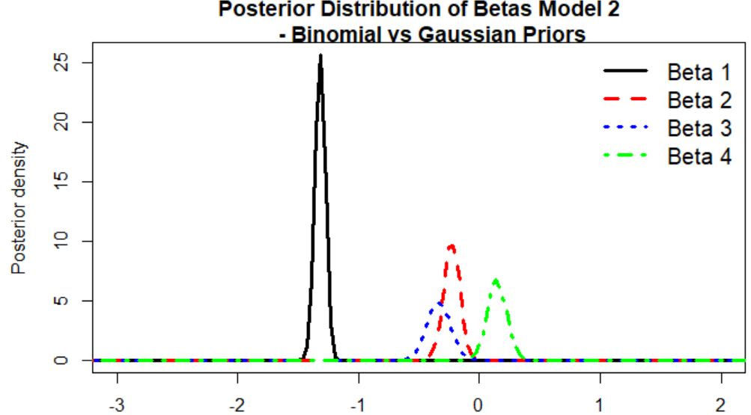
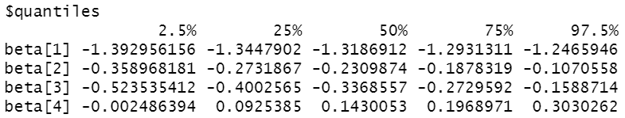
Binomial – Logistic Model
Y_{i}~ ~ Binomial(p[i], n[i])
Probit(p[i]) ~ (β₁ + X_{i1}β₁ + X_{i2}β₃+X_{i3}β₄)
X_{i1}=Presidential approval rate X_{i2}=Congressional Approval Rate X_{i3}=Supreme Court confidence rate n=Number of races run Y_{i} = US House seat loss by party of president (0,1)
Pramodini Karwande
Notes:
An important step in any Bayesian workflow, is to assess the prior distribution’s influence on the final inference. In order to check prior sensitivity, we studied the posterior distribution, using a variety of prior distributions and observe, there is no change in the posterior, despite we used, either different priors or same priors with different range of values. It provides robustness of our Binomial – Logistic Model. We observe that the credible intervals for the values of coefficients for Presidential approval rate and Congressional Approval Rate are overlapping except the values of coefficient for Supreme Court confidence rate and intercept.

Slide 9
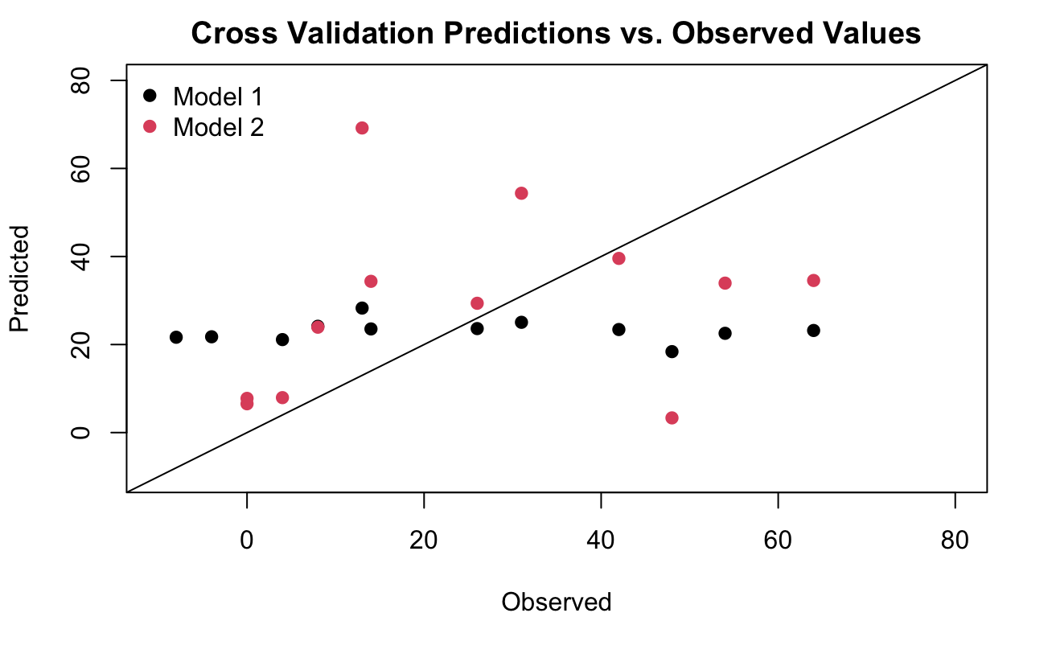
Model Comparison–Simple Linear vs. Binomial Logistic
Due to the small number of samples, leave-one-out cross validation was selected to compare how well the Simple Linear Model and the Binomial Logistic Model predict out of sample data.
 | Simple Linear Model | Binomial Logistic Model
Bias | -1.18 | 2.60
MSE | 529.98 | 592.21
MAD | 20.22 | 19.12
Coverage | 1.00 | 0.25
Width | 102.73 | 22.92
The simple linear model shows a lower MSE and better coverage, indicating a better fit. However, as the plot shows, the model is not particularly good at predicting the data, especially in years with a high number of seats flipped.
Nicole Levin
Notes:
Since the data set only includes 12 samples, this analysis was a perfect candidate for leave-one-out cross validation. Both models were fit with one data point left out at a time and evaluated on how well the model predicts the data point left out . This functions as a form of out-of-sample prediction. We performed an MCMC sampling with 10000 burn-in samples and 20000 post-burn-in samples for each of the leave-one-out data sets to train each model and use the resulting model to predict the left out data point. The results of the cross validation show a better fit with the simple linear model, as the MSE is lower and the coverage is much better. However, as can be seen in the plot, the simple linear model does not do a particularly good job of predicting the actual observed values, with mean predicted values around 20 seats flipped for all data points.

Slide 10
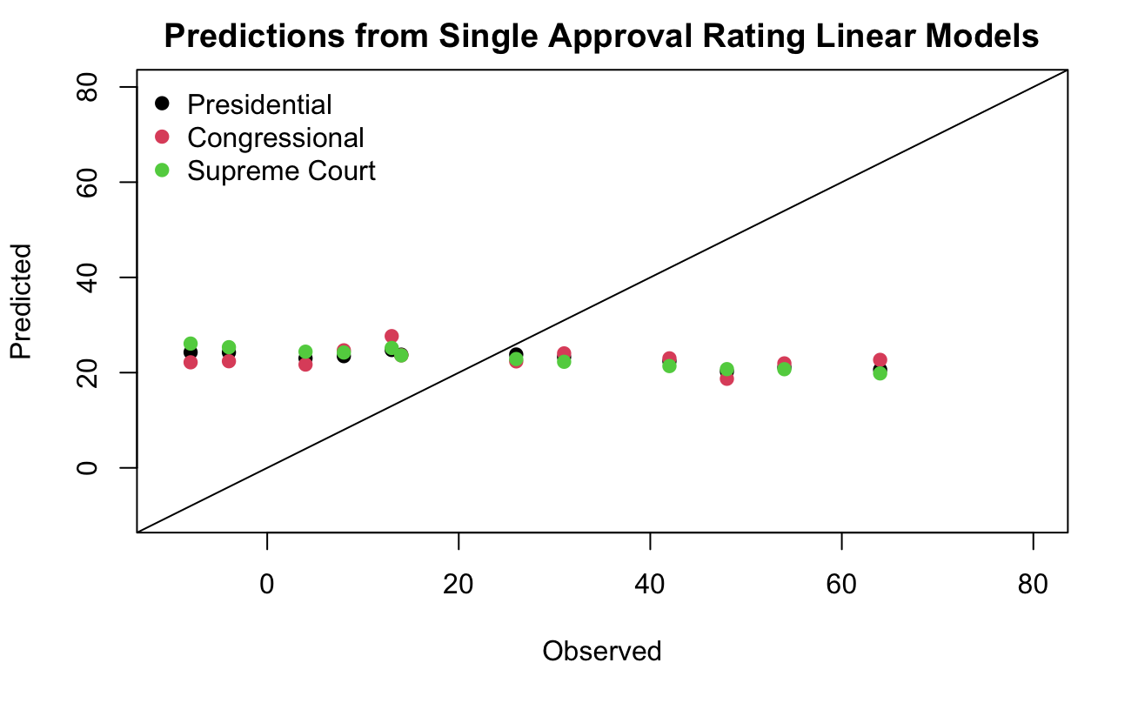
Model Comparison of
Simple Linear Models
As there is a very high correlation between presidential, congressional, and Supreme Court approval ratings, cross validation was also performed on simple linear regression models that only included one of the approval rating variables.
 | All Ratings Included | Presidential Approval | Congressional Approval | Supreme Court Approval
Bias | -1.18 | -1.43 | -1.42 | -1.29
MSE | 529.98 | 569.94 | 540.53 | 603.58
MAD | 20.22 | 20.82 | 20.56 | 21.55
Coverage | 1.00 | 1.00 | 1.00 | 1.00
Width | 102.73 | 105.72 | 103.03 | 108.16
Of the models based on only one approval rating, the Congressional approval rating model shows the best fit. The model including all three ratings shows the lowest MSE, but there is not much difference between the full model and the model with only Congressional approval included.
Nicole Levin
Notes:
After selecting the Simple linear regression model as the better fitting model through cross validation, cross validation was also performed on simple linear regression models that each only included one of the approval rating variables. As shown earlier in the presentation there is a very high correlation between presidential, congressional, and Supreme Court approval ratings, so a simpler model using only one of the approval ratings may be preferable. The model with all of the approval ratings included showed the lowest MSE, but there is not a large difference between that and the model using only Congressional approval. All models showed great coverage, but also a large credible interval width. As was the case with the simple model including all three approval ratings, none of these models do a particularly good job of predicting the actual observed values, with mean predicted values around 20 seats flipped for all data points.

Slide 11
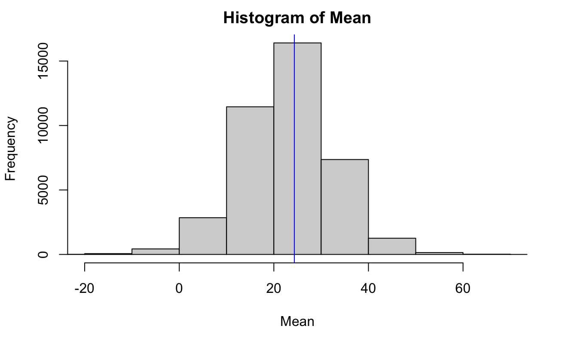
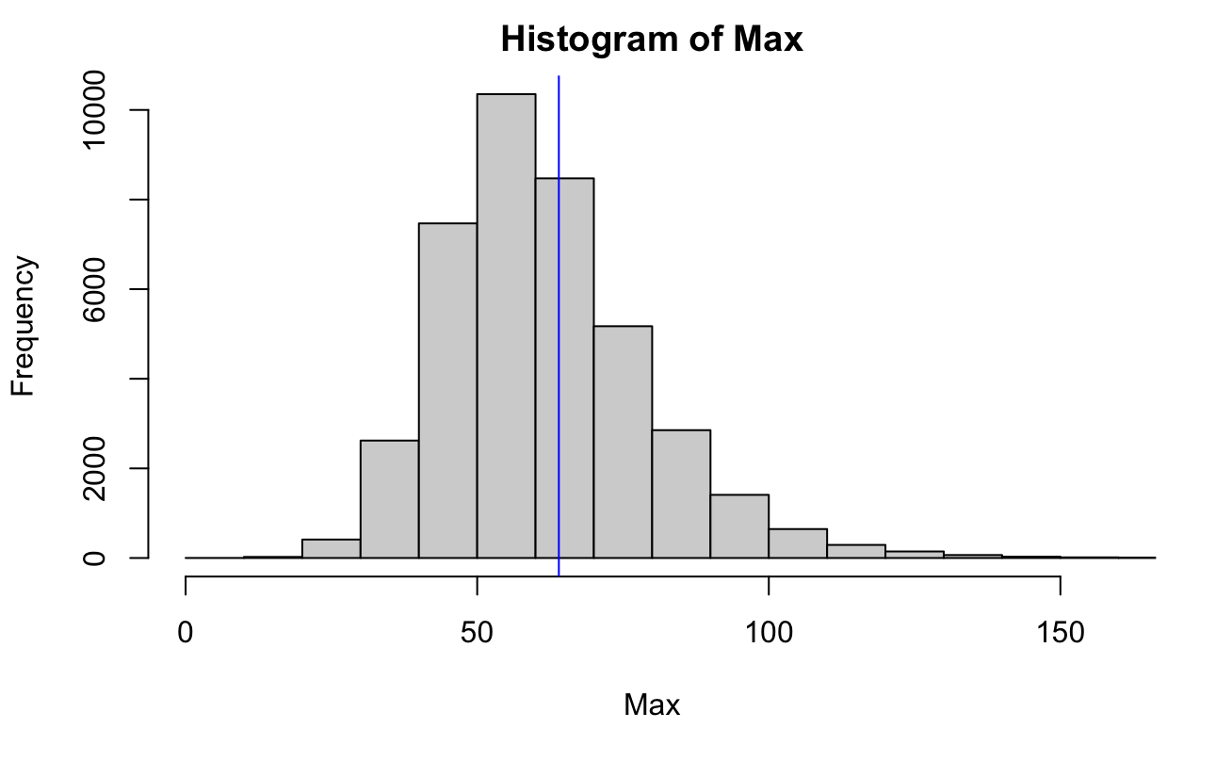
Posterior Predictive Checks
Posterior predictive checks of the mean and maximum were used to test how well the Simple Linear Regression model fits the dataset. As can be seen below, the observed mean and maximum are well captured by the model estimates, but the range in the histograms is large.
Nicole Levin
Notes:
Posterior predictive checks of the mean and maximum were used to test how well the Simple Linear Regression model fits the dataset. As can be seen below, the observed mean and maximum are well captured by the model estimates, but the range in the histograms is large. This lines up with the great coverage, but large interval ranges, that we saw in cross validation. The results for maximum here show some values well above 100, much higher than any numbers of seat flips seen in the actual data.

Slide 12
Implications
Approval ratings between branches is highly correlated
Overlap of credible intervals for coefficients suggest no credible difference between effect of variables
Parsimony and comparative performance justify the use of a single variable model
Actual results vary widely from the model predictions.
Notes:
For better or for worse, our study implies that neither Congressional nor Legislative approval ratings credulously improve the model for predicting mid-term US House seat flips. This is likely due to the high amount of correlation between the approval ratings of the three branches. Our study also finds a large amount of variation between outcomes and model predictions, suggesting that we are perhaps not capturing additional valuable inputs.

Slide 13

Further Questions
Could the use of threshold values model this better?
Would economic, international, and social trends model this phenomenon better?
What, if anything, helps break the correlation between the approval ratings of the different branches? Why are these ratings so highly correlated?
Notes:
In Gallup’s study of mid-term Congressional seat changes, the presidential approval rating was treated as a threshold indicator variable, while we treated it as direct value. Would our models improve if we applied thresholds and transformed the approval ratings to indicator variables? Further investigation could also be conducted into additional variables that might significantly improve the performance of this model. Finally, additional research into the correlation of approval ratings that we observed might be valuable for social and political scientists.

